Slide 1
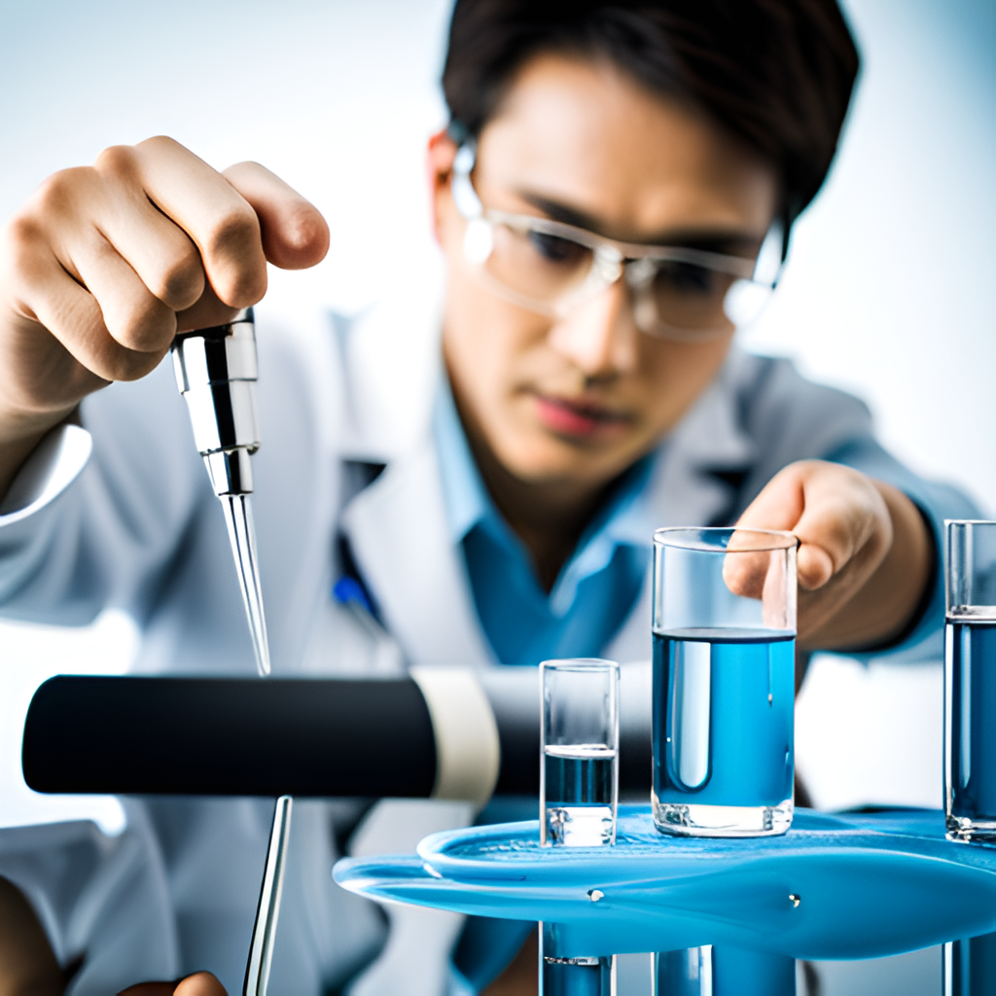
Innovative Data Extraction for Water Quality Analysis

Slide 2
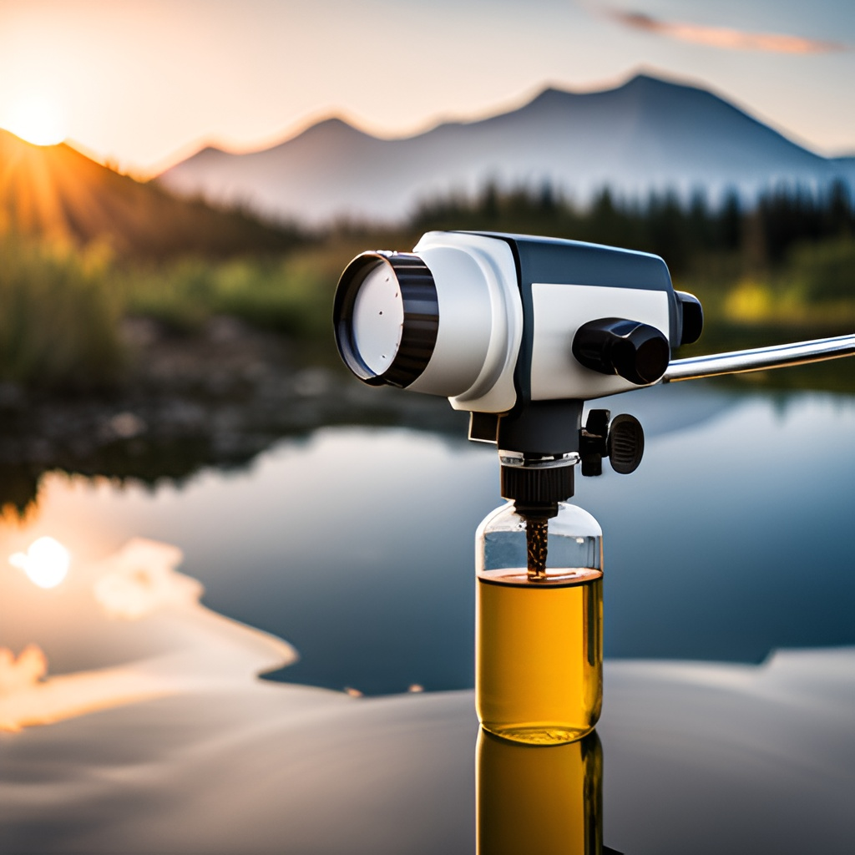
IMPORTANCE OF WATER ANALYSIS
Water quality analysis is essential for ensuring the safety and health of individuals and the environment. It involves testing water samples for various contaminants, including bacteria, chemicals, and minerals. The data obtained from water quality analysis is used to identify potential health hazards and to implement measures to protect public health and the environment.
Water quality analysis is critical for various industries, including agriculture, manufacturing, and healthcare. It is also important for recreational activities such as swimming and fishing. In addition, water quality analysis is necessary for regulatory compliance with local, state, and federal laws

Slide 3
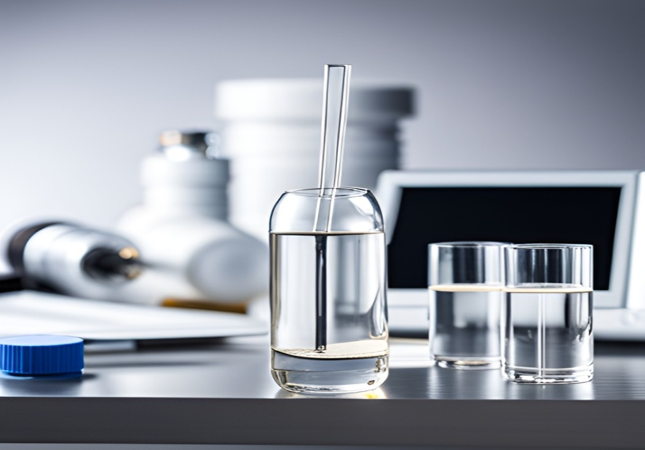

Current Data Extraction Methods
LABORATORY ANALYSIS
FIELD TESTING
Laboratory analysis is a common method for extracting data on water quality. Samples are collected and analyzed in a lab setting using various techniques such as spectrophotometry and chromatography
Field testing involves collecting samples on-site and using portable equipment to analyze them. This method provides real-time results and is commonly used for monitoring water quality in remote areas.

Slide 4
Limitations of Current Methods
Challenges in Water Quality Analysis:
Current data extraction methods for water quality analysis have several limitations. These include limited spatial and temporal resolution, high costs, and the need for trained personnel to operate and maintain the equipment. Additionally, traditional methods may not detect emerging contaminants or provide real-time data.
Limited Spatial and Temporal Resolution
Current methods of water quality analysis are often limited in their ability to provide detailed spatial and temporal data. Traditional sampling methods, such as grab sampling, only provide a snapshot of water quality at a single point in time and space. This can result in an incomplete understanding of water quality dynamics

Slide 5
High Costs
Current methods of water quality analysis can be expensive, requiring specialized equipment and trained personnel. The costs associated with these methods can limit the frequency and extent of water quality monitoring, resulting in a lack of data for decision-making.
Emerging Contaminants and Real-Time Data
Traditional methods of water quality analysis may not detect emerging contaminants or provide real-time data.
Emerging contaminants, such as microplastics and pharmaceuticals, are not typically included in standard water quality tests.
Additionally, traditional methods may not provide real-time data, which can limit the ability to respond quickly to changes in water quality.

Slide 6

Innovative Data Extraction Techniques
Traditional methods of water quality analysis can be time-consuming and expensive.
Innovative data extraction techniques are being developed to improve the speed and accuracy of water quality analysis, allowing for more efficient and effective monitoring of water resources.

Slide 7
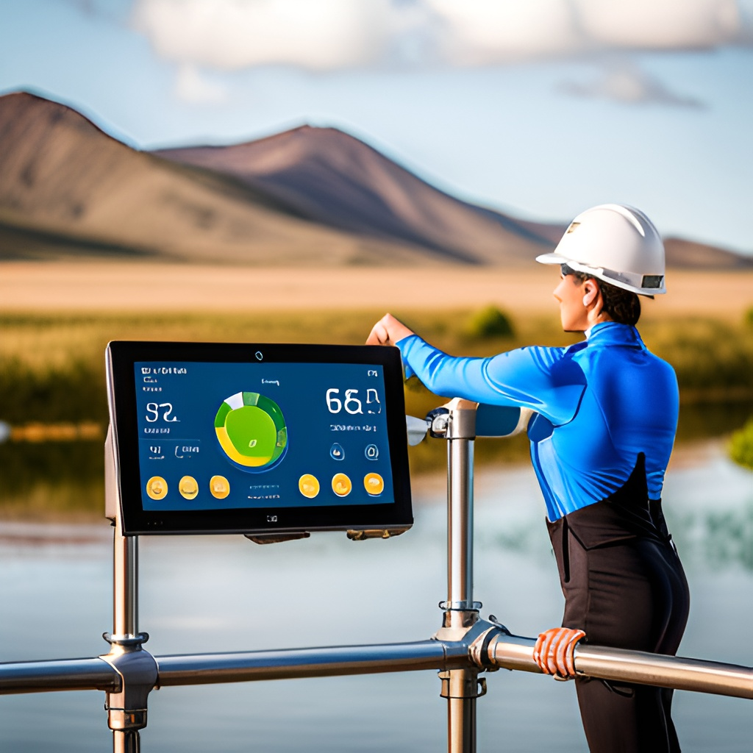
Machine Learning for Water Quality Analysis
Machine learning algorithms can be used to analyze large amounts of water quality data and identify patterns and trends.
This can help to identify potential issues before they become major problems, and allow for proactive measures to be taken to protect water resources.

Slide 8

APPLICATIONS OF MACHINE LEARNING:
Machine learning algorithms can be used for a variety of water quality analysis applications, including predicting water quality parameters, identifying sources of contamination, and detecting anomalies in water quality data.
These algorithms can also be used to develop predictive models that can help water treatment facilities optimize their operations and reduce costs.

Slide 9

BENEFITS OF MACHINE LEARNING
Machine learning can provide more accurate and efficient analysis of water quality data, reducing the need for manual analysis and potentially improving the speed and accuracy of decision-making.
Additionally, machine learning can help identify trends and patterns that may not be easily discernible through traditional analysis methods, leading to more effective water quality management strategies.

Slide 10
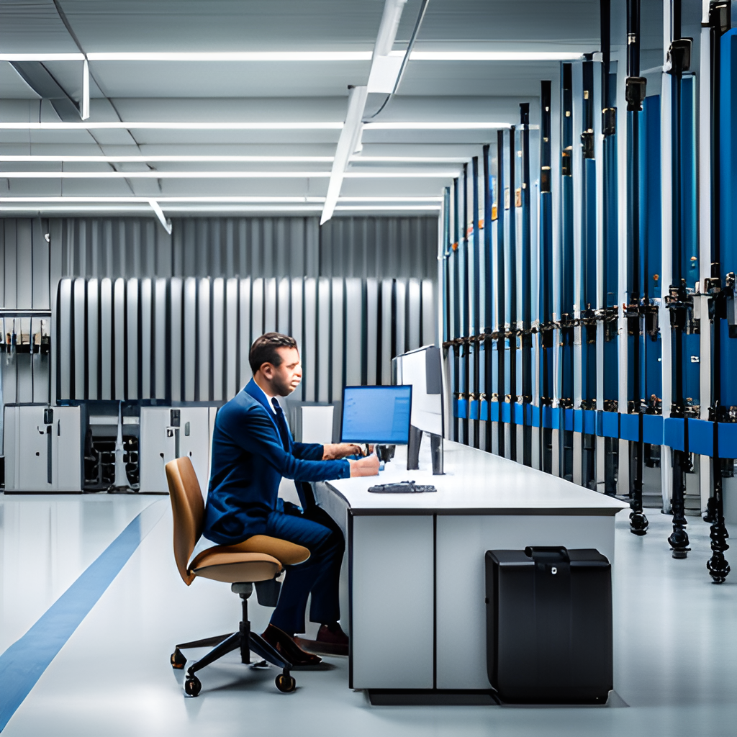
Data Visualization Techniques
Data visualization techniques can be used to present water quality data in a clear and concise manner.
This can help to identify trends and patterns that may not be immediately apparent from raw data, and can aid in decision-making processes.

Slide 11

Line Graphs
Line graphs are a common visualization technique for showing trends in water quality over time. They can help identify patterns and changes in water quality, which can inform decision-making.

Slide 12
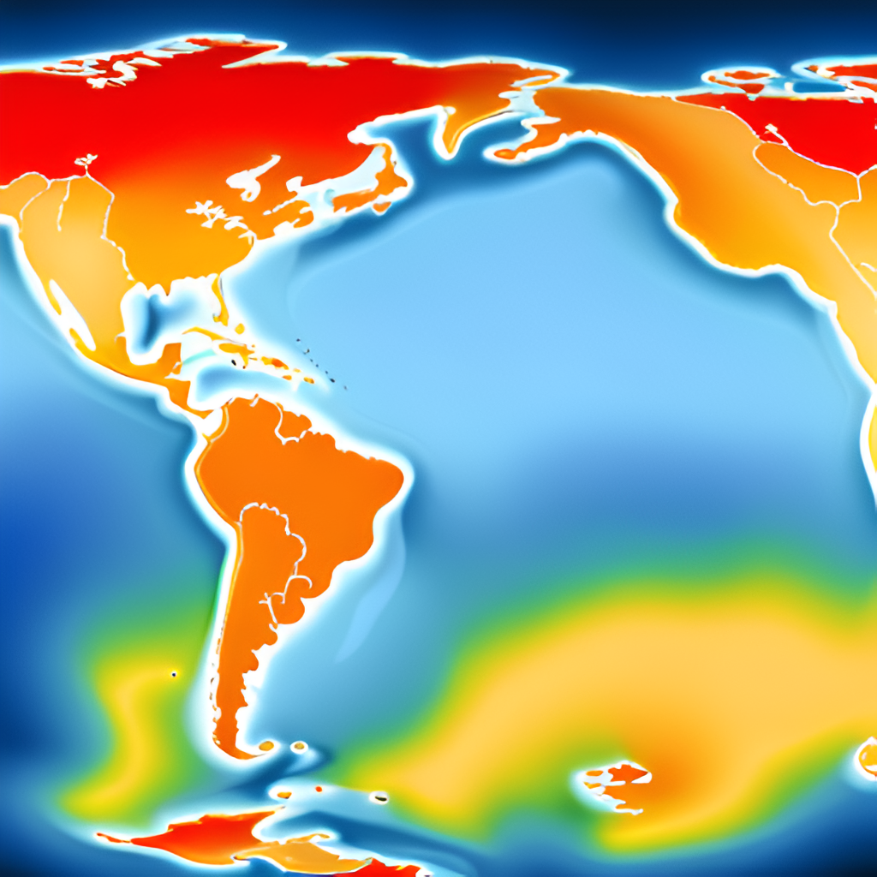
Heat Maps
Heat maps are useful for visualizing spatial patterns in water quality across different regions. They can help identify areas of concern and prioritize monitoring and remediation efforts.

Slide 13
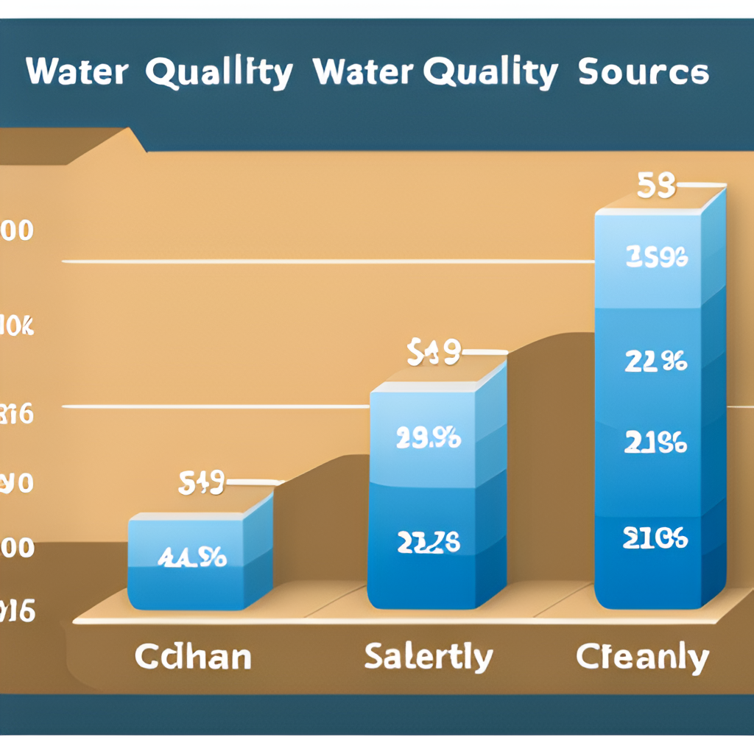
Bar Charts
Bar charts can be used to compare water quality across different sources, such as different rivers or treatment plants. They can help identify sources of contamination and inform management decisions.

Slide 14
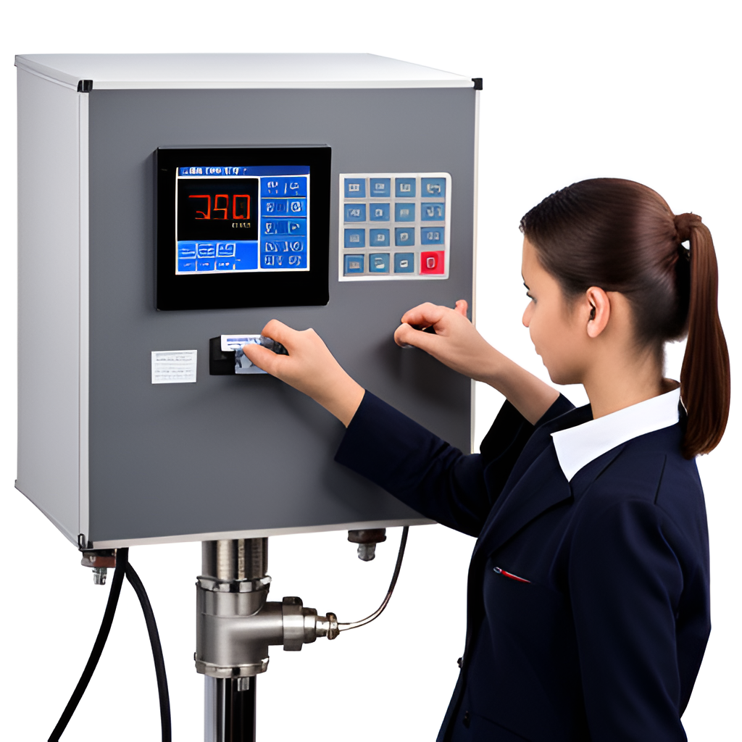
Real-Time Monitoring for Accurate Analysis
Real-time monitoring allows for continuous data collection and analysis, providing a more accurate representation of water quality over time.

Slide 15

Case Study 1: Municipal Water Treatment Plant
A municipal water treatment plant in California implemented machine learning algorithms to predict potential water quality issues before they occurred. The system was trained on historical data and was able to detect anomalies in real-time, allowing the plant to take corrective action before any contamination occurred. This resulted in improved water quality and reduced risk of public health issues.

Slide 16
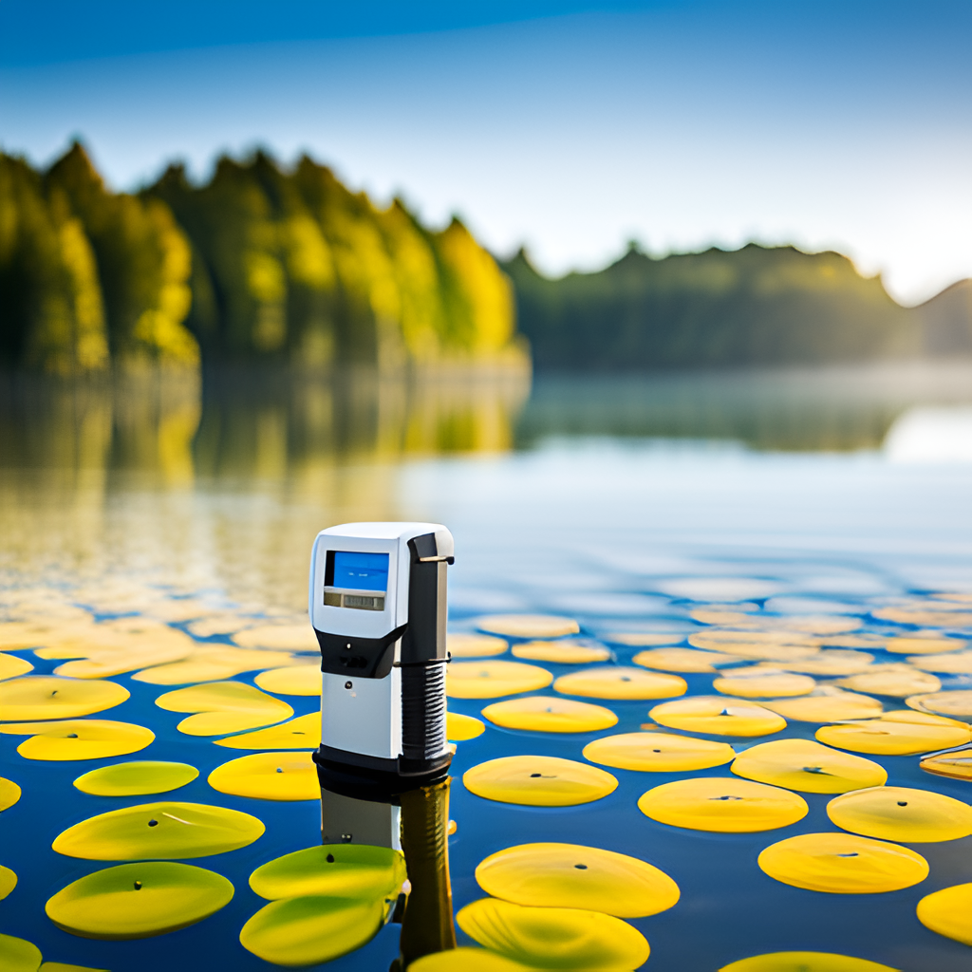
Case Study 2: Private Well Owners
A company in the Midwest developed a low-cost, portable water quality testing kit for private well owners.
The kit included a smartphone app that used machine learning to analyze the test results and provide recommendations for any necessary corrective actions.
This allowed private well owners to monitor their water quality more frequently and take action to address any issues before they became more serious.

Slide 17
Challenges and Future Developments
Data Quality and Consistency
One of the biggest challenges in water quality analysis is ensuring data quality and consistency. Future developments should focus on improving data collection methods and standardizing data formats to ensure that data can be easily analyzed and compared across different regions and time periods.
﻿ Integration with IoT and Smart Cities
As cities become smarter, there is an opportunity to integrate water quality monitoring with IoT devices and smart city infrastructure. This could enable real-time monitoring and early warning systems for water quality issues.
﻿
Advanced Machine Learning Techniques
Machine learning has the potential to greatly improve water quality analysis by identifying patterns and predicting future trends. Future developments should focus on developing more advanced machine learning algorithms that can handle large and complex datasets, and integrating these algorithms into existing water quality analysis tools.

Slide 18
Cost-Benefit Analysis :
Evaluating the Costs and Benefits of Water Quality Analysis
Water quality analysis can be expensive, but it is crucial for ensuring the safety of our water supply. Conducting a cost-benefit analysis can help decision-makers determine the most effective and efficient methods for water quality analysis.
Costs of Water Quality Analysis
Laboratory equipment and supplies
Labor costs for sample collection and analysis
Transportation costs for sample collection and delivery
Data management and analysis software
Benefits of Water Quality Analysis
Identification of potential health hazards
Detection of contaminants before they become widespread
Compliance with regulatory standards
Protection of aquatic ecosystems

Slide 19
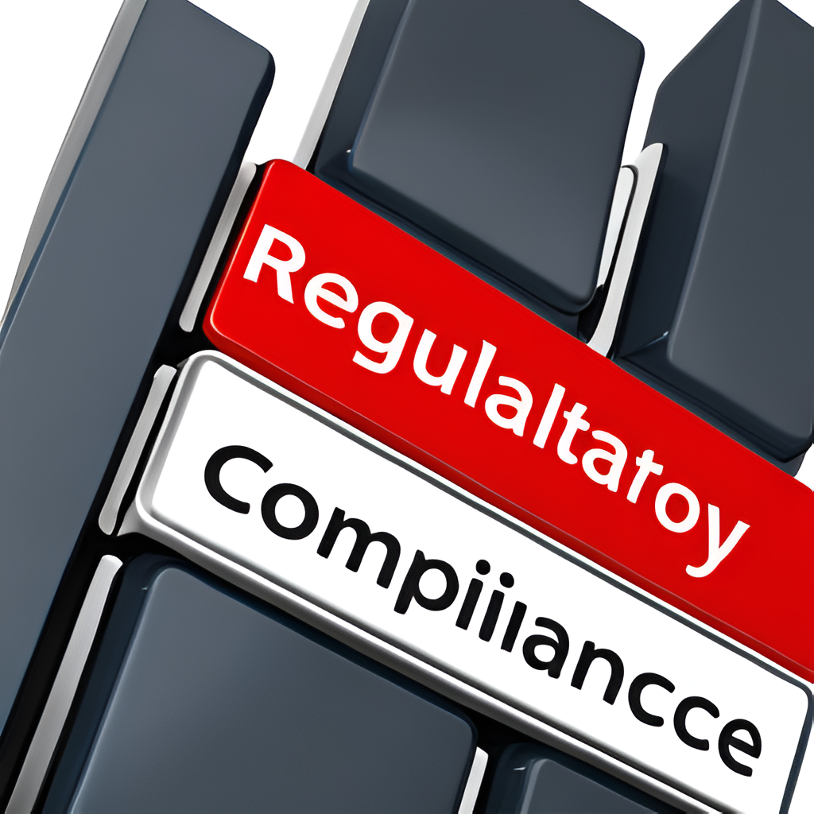
Regulatory Compliance
Water quality analysis is subject to strict regulatory standards set by government agencies such as the EPA. Failure to comply with these regulations can result in fines and legal action.
Current data extraction methods may not meet regulatory requirements, leading to non-compliance issues.
Innovative data extraction techniques can improve accuracy and reliability of water quality data, ensuring compliance with regulations.

Slide 20
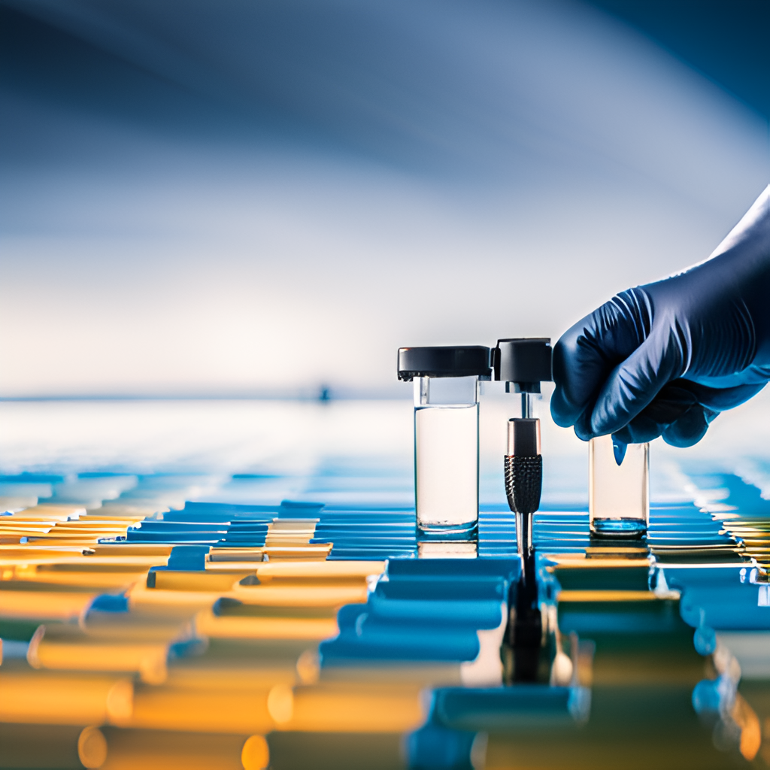
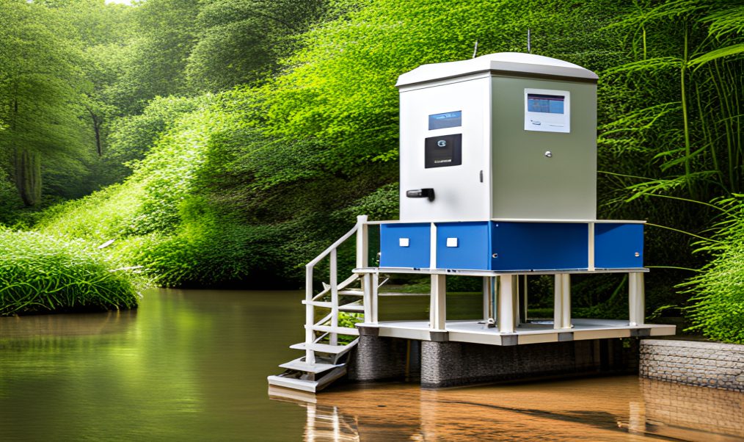
Next Steps and Recommendations
Investing in Innovative Techniques :
Investing in innovative techniques such as machine learning and real-time monitoring can greatly improve the efficiency and accuracy of water quality analysis. It is recommended that organizations prioritize the allocation of resources towards implementing these cutting-edge methods.
Collaboration and Knowledge Sharing :
Collaborating with other organizations and sharing knowledge and data can lead to a more comprehensive understanding of water quality issues and better solutions. It is recommended that organizations actively seek out opportunities for collaboration and knowledge sharing.
Regulatory Compliance :
Organizations must ensure that they are complying with all relevant regulations and standards for water quality analysis. It is recommended that organizations regularly review and update their compliance procedures to stay up-to-date with any changes in regulations.

Slide 21
Conclusion
Water quality analysis is essential for ensuring safe and healthy water for human consumption and environmental protection. Current data extraction methods have limitations and may not provide accurate and timely information. However, innovative data extraction techniques such as machine learning and real-time monitoring can improve the accuracy and efficiency of water quality analysis. Additionally, data visualization techniques can help communicate complex data to stakeholders and facilitate decision-making. Successful case studies demonstrate the potential benefits of these techniques for improving water quality analysis. Regulatory compliance and cost-benefit analysis are important considerations for implementing these techniques. Future developments in this field hold promise for further improving water quality analysis. It is recommended that organizations invest in these innovative techniques to improve water quality analysis and ensure safe and healthy water for all.

